Slide 1

APEX INSTITUTE OF TECHNOLOGY
DEPARTMENT OF COMPUTER SCIENCE & ENGINEERING
Computer Organization & Architecture (21CSH-281)
Faculty: Siddharth Kumar (E12853)
Lecture - 4
Functional Blocks of a Computer: CPU, Memory, Input-output Subsystems, Control Unit
DISCOVER . LEARN . EMPOWER

Slide 2
Computer Organization & Architecture: Course Objectives
COURSE OBJECTIVES
The course aims to:
The purpose of the course is to introduce principles of computer organization and the basic architectural concepts.
It begins with basic organization, design, and programming of a simple digital computer and introduces simple register transfer language to specify various computer operations.
Topics include computer arithmetic, instruction set design, microprogrammed control unit, pipelining and vector processing, memory organization and I/O systems, and multiprocessors.
To familiarize Students with the detailed Architectures of a Central Processing Unit.
Learn the different types of serial communication techniques.

Slide 3
COURSE OUTCOMES
On completion of this course, the students shall be able to:-
CO1 | Identify and interpret the basics of instruction sets and their impact on the design, organization, and functionality of various functional units of a computer comparable to the CPU, memory organization, I/O organization, and parallel processors.
CO2 | Analysis of the design of arithmetic & logic unit and understanding of the fixed point and floating-point arithmetic operations.
CO3 | Relate cost performance and design trade-offs in designing and constructing a computer processor which includes memory.
CO4 | Understanding the different ways of communicating with I/O devices and standard I/O interfaces.
CO5 | Implementation of control unit techniques and the concept of Pipelining.

Slide 4
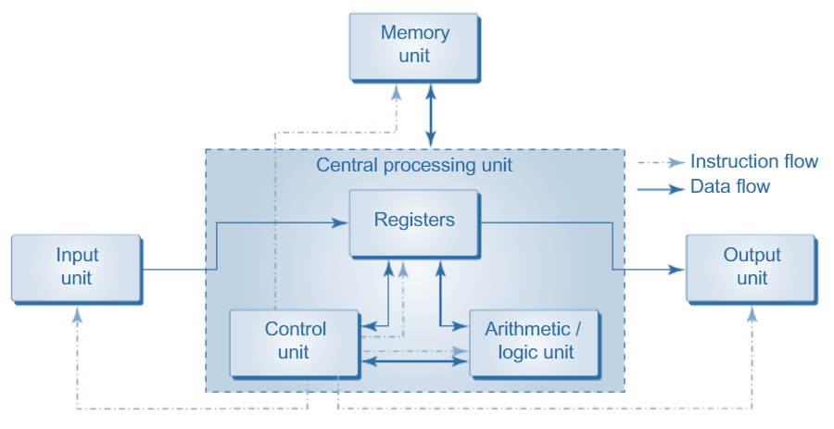
Central Processing Unit
Central Processing Unit commonly known as CPU can be referred as an electronic circuitry within a computer that carries out the instructions given by a computer program by performing the basic arithmetic, logical, control and input/output (I/O) operations specified by the instructions.
A CPU is also called a processor, central processor, or microprocessor. It carries out all the important functions of a computer.
CPU is installed or inserted into a CPU socket located on the motherboard. Furthermore, it is provided with a heat sink to absorb and dissipate heat to keep the CPU cool and functioning smoothly. It has subunits.
CU(Control Unit)
ALU(Arithmetic & logical Unit)
Registers
Common System Bus Structure
Figure: Block Diagram of Computer of Digital Computer

Slide 5
Control Unit: It is the circuitry in the control unit, which makes use of electrical signals to instruct the computer system for executing already stored instructions. It takes instructions from memory and then decodes and executes these instructions. So, it controls and coordinates the functioning of all parts of the computer. The Control Unit's main task is to maintain and regulate the flow of information across the processor. It does not take part in processing and storing data.
ALU: It is the arithmetic logic unit, which performs arithmetic and logical functions. Arithmetic functions include addition, subtraction, multiplication division, and comparisons. Logical functions mainly include selecting, comparing, and merging the data. A CPU may contain more than one ALU. Furthermore, ALUs can be used for maintaining timers that help run the computer.
Memory or Storage Unit/ Registers: It is called Random access memory (RAM). It temporarily stores data, programs, and intermediate and final results of processing. So, it acts as a temporary storage area that holds the data temporarily, which is used to run the computer.
Common System Bus Structure: Physical Medium used to exchange data between various components of computer is called as bus or system bus.

Slide 6
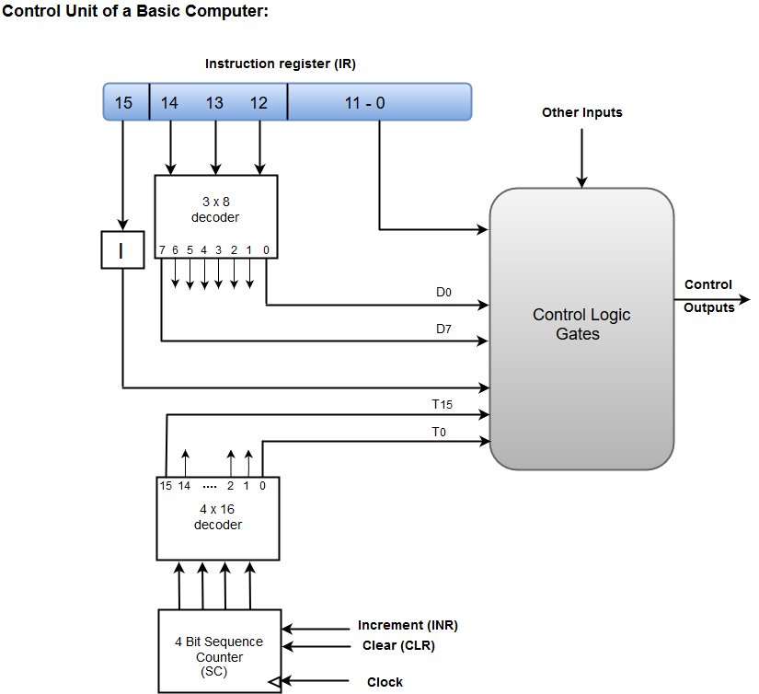
Control Unit
The Control Unit is classified into two major categories:
Hardwired Control
Microprogrammed Control
Hardwired Control: The Hardwired Control organization involves the control logic to be implemented with gates, flip-flops, decoders, and other digital circuits. The following image shows the block diagram of a Hardwired Control organization.
A Hard-wired Control consists of two decoders, a sequence counter, and a number of logic gates.
An instruction fetched from the memory unit is placed in the instruction register (IR).
Figure: Hardwired Control

Slide 7
The component of an instruction register includes; I bit, the operation code, and bits 0 through 11.
The operation code in bits 12 through 14 are coded with a 3 x 8 decoder.
The outputs of the decoder are designated by the symbols D0 through D7.
The operation code at bit 15 is transferred to a flip-flop designated by the symbol I.
The operation codes from Bits 0 through 11 are applied to the control logic gates.
The Sequence counter (SC) can count in binary from 0 through 15.
Micro-programmed Control: The Microprogrammed Control organization is implemented by using the programming approach.
In Microprogrammed Control, the micro-operations are performed by executing a program consisting of micro-instructions.
The following image shows the block diagram of a Microprogrammed Control organization.

Slide 8
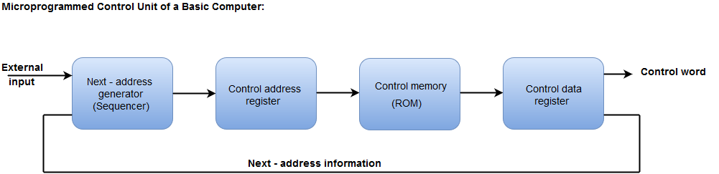
Figure: Micro-programmed Control
The Control memory address register specifies the address of the micro-instruction.
The Control memory is assumed to be a ROM, within which all control information is permanently stored.
The control register holds the microinstruction fetched from the memory.
The micro-instruction contains a control word that specifies one or more micro-operations for the data.
While the micro-operations are being executed, the next address is computed in the next address generator circuit and then transferred into the control address register to read the next microinstruction.
The next address generator is often referred to as a micro-program sequencer, as it determines the address sequence that is read from control memory.

Slide 9
Arithmetic Logic Unit (ALU)
Most of all the arithmetic and logical operations of a computer are executed in the ALU (Arithmetic and Logical Unit) of the processor. It performs arithmetic operations like addition, subtraction, multiplication, division and also the logical operations like AND, OR, NOT operations.
In the computer system, ALU is a main component of the central processing unit, which stands for arithmetic logic unit and performs arithmetic and logic operations. It is also known as an integer unit (IU) that is an integrated circuit within a CPU or GPU, which is the last component to perform calculations in the processor.
It has the ability to perform all processes related to arithmetic and logic operations such as addition, subtraction, and shifting operations, including Boolean comparisons (XOR, OR, AND, and NOT operations). Also, binary numbers can accomplish mathematical and bitwise operations. The arithmetic logic unit is split into AU (arithmetic unit) and LU (logic unit). The operands and code used by the ALU tell it which operations have to perform according to input data. When the ALU completes the processing of input, the information is sent to the computer's memory.

Slide 10
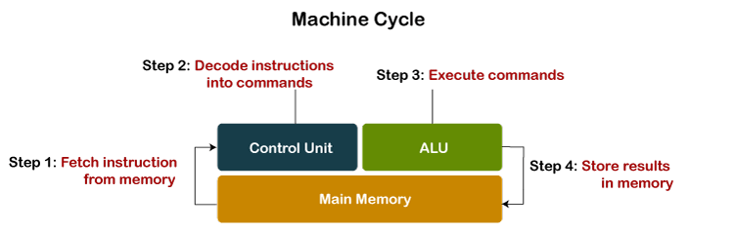
Except performing calculations related to addition and subtraction, ALUs handle the multiplication of two integers as they are designed to execute integer calculations; hence, its result is also an integer.
However, division operations commonly may not be performed by ALU as division operations may produce a result in a floating-point number.
Instead, the floating-point unit (FPU) usually handles the division operations; other non-integer calculations can also be performed by FPU.
Although the ALU is a major component in the processor, the ALU's design and function may be different in the different processors.
For case, some ALUs are designed to perform only integer calculations, and some are for floating-point operations.
Figure: Machine Cycle with ALU

Slide 11
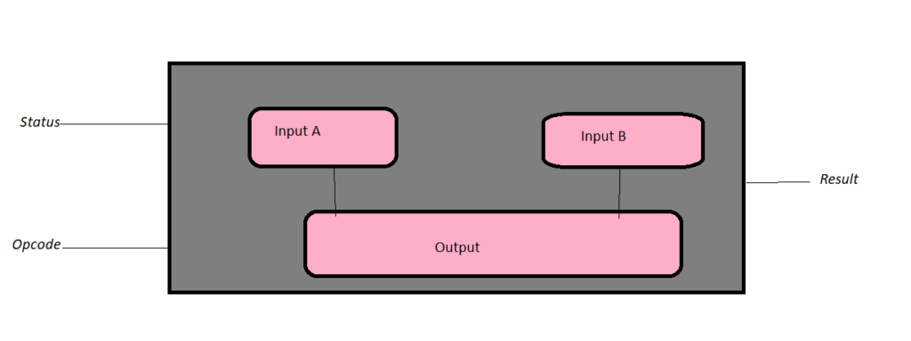
The operations performed by ALU are:
Logical Operations: The logical operations consist of NOR, NOT, AND, NAND, OR, XOR, and more.
Bit-Shifting Operations: It is responsible for displacement in the locations of the bits to the by right or left by a certain number of places that are known as a multiplication operation.
Arithmetic Operations: Although it performs multiplication and division, this refers to bit addition and subtraction. But multiplication and division operations are more costly to make. In the place of multiplication, addition can be used as a substitute and subtraction for division.
Figure: Signals in ALU

Slide 12
Registers Memory
Register memory is the smallest and fastest memory in a computer.
It is not a part of the main memory and is located in the CPU in the form of registers, which are the smallest data holding elements.
A register temporarily holds frequently used data, instructions, and memory address that are to be used by CPU. They hold instructions that are currently processed by the CPU.
All data is required to pass through registers before it can be processed. So, they are used by CPU to process the data entered by the users.
Registers hold a small amount of data around 32 bits to 64 bits. The speed of a CPU depends on the number and size (no. of bits) of registers that are built into the CPU.
Registers can be of different types based on their uses. Some of the widely used Registers include Accumulator or AC, Data Register or DR, the Address Register or AR, Program Counter (PC), I/O Address Register, and more.

Slide 13
Types and Functions of Computer Registers:
Data Register: It is a 16-bit register, which is used to store operands (variables) to be operated by the processor. It temporarily stores data, which is being transmitted to or received from a peripheral device.
Program Counter (PC): It holds the address of the memory location of the next instruction, which is to be fetched after the current instruction is completed.
Instructor Register: It is a 16-bit register. It stores the instruction which is fetched from the main memory. So, it is used to hold instruction codes, which are to be executed. The Control Unit takes instruction from Instructor Register, then decodes and executes it.
Accumulator Register: It is a 16-bit register, which is used to store the results produced by the system. Address Register: It is a 12-bit register that stores the address of a memory location where instructions or data is stored in the memory.
I/O Address Register: Its job is to specify the address of a particular I/O device.
I/O Buffer Register: Its job is to exchange the data between an I/O module and the CPU.

Slide 14
Common System Bus of Computer
Physical Medium used to exchange data between various components of computer is called as bus or system bus.
Data Bus: Used to transfer Data
Address Bus: Used to transfer Addresses
Control Bus: Used to transfer Control Signal
A system bus is a single computer bus that connects the major components of a computer system, combining the functions of a data bus to carry information, an address bus to determine where it should be sent or read from, and a control bus to determine its operation.
Common Bus system is used to provides the path to transfer data from register to register or in-between the registers and memory.
Common Bus System uses a multiplexer to implement Common BUS.

Slide 15
Summary
Discussed about Control Unit.
Discussed the working of control unit.
Learn about the ALU.
Learn about the Registers.
Learn about the BUSs.
Assessment Questions
Q1. What are some of the components of a CPU.
Q2. Which component of a computer moderates the action of its other components?

Slide 16
THANK YOU

